Slide 1

CS 533 INTRO TO DATA SCIENCE
Michael Ekstrand

Slide 2
DATA TYPES AND FORMATS

Slide 3

Learning Outcomes
Understand broad categories of data formats
Know where to look for particular data formats
Read data in different encodings
Photo by Joshua Newton on Unsplash

Slide 4



Types of Data
Tabular is organized into columns and rows like a spreadsheet.
Each row has the same shape & attributes.
Semi-Structured data has structure, like labeled fields, but different objects can have different fields.
Unstructured data has no defined structure. Includes raw text and images.

Slide 5
Tabular Data
Delimited text
Comma-separated (CSV)
Tab-separated (TSV)
Spreadsheet files
Excel (xlsx or xls)
Sometimes actually TSV 🤦‍♂️
“.dat” means nothing
Binary formats
HDF
NetCDF
Parquet
Other
Matlab
STATA
…

Slide 6
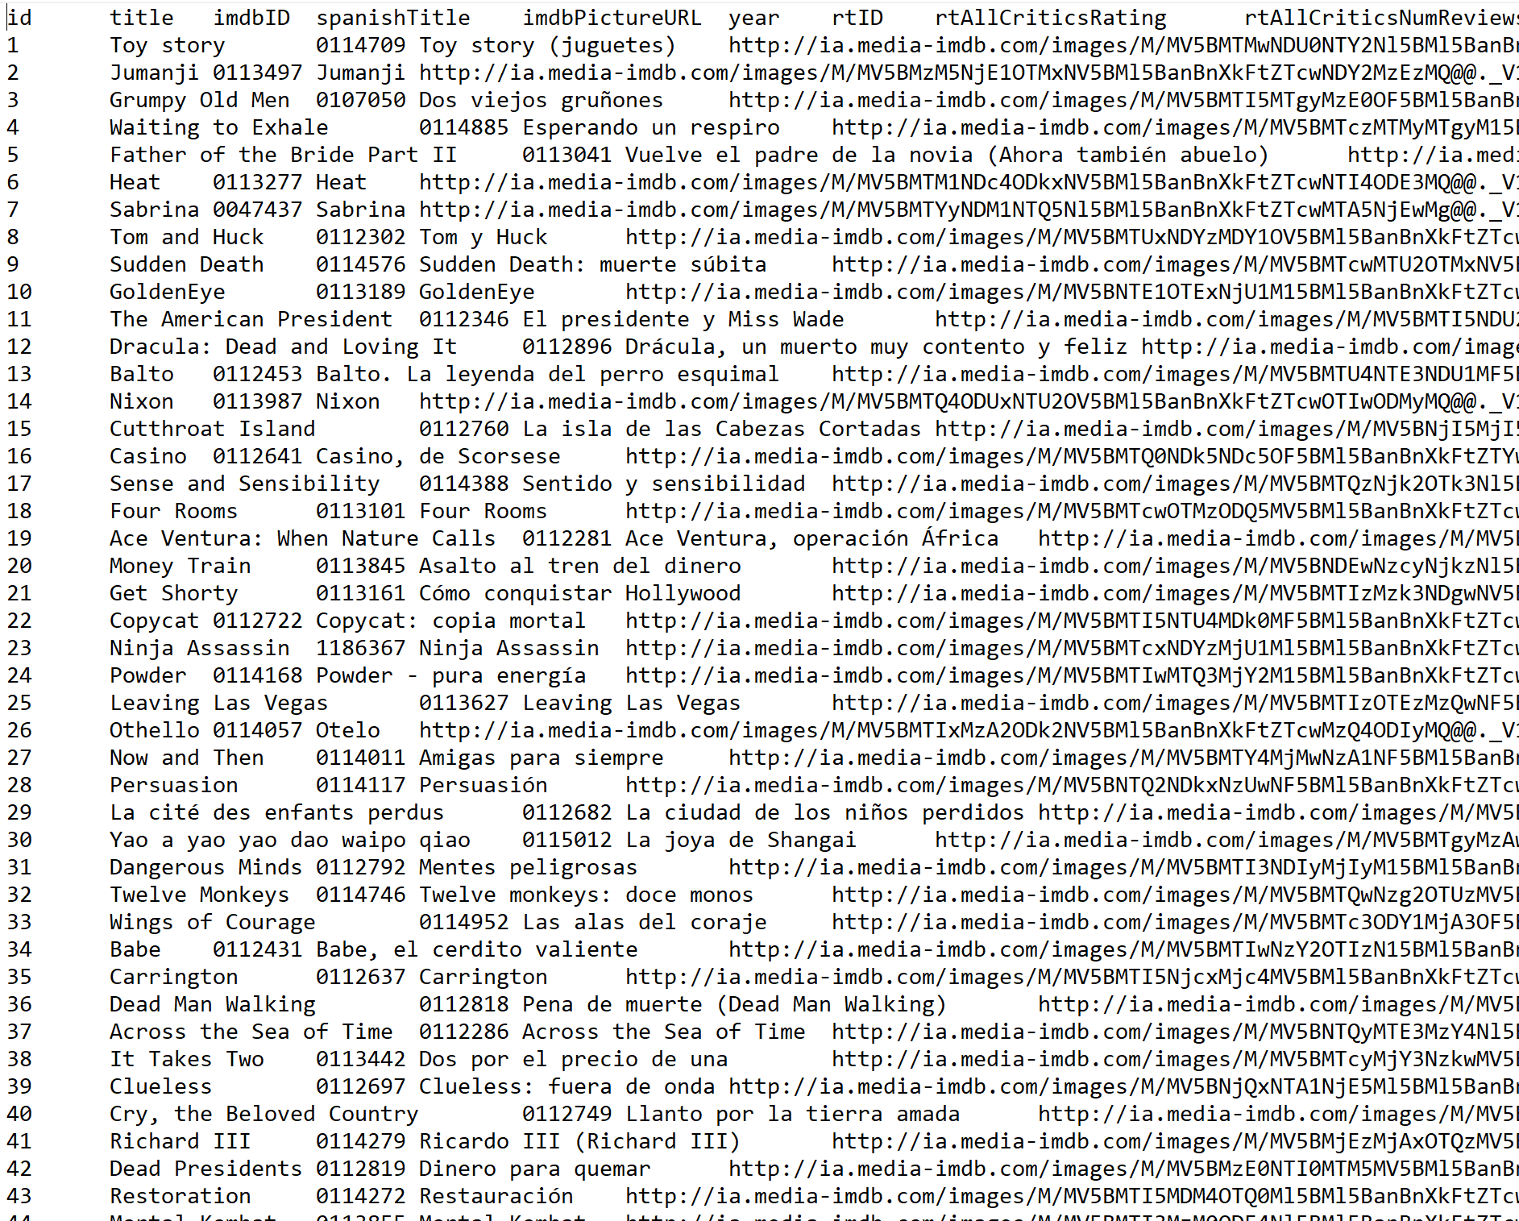
Delimited Text
One record per line (usually)
Delimiter: comma, tab (\t), |, …
Escape:
Quotes: "field"
Double-up quotes to escape inside
Backslashes
Header: usually first row
Pandas read_csv / to_csv pretty portable (though watch index!)

Slide 7

Semi-Structured Data
JSON: dictionaries, lists, strings, numbers, true/false, null
XML: trees of nodes with text and attributes
YAML: JSON ++
MSGPACK
RDF, SQL
Others…
{ "fit": "fit", "user_id": "420272", "bust size": "34d", "item_id": "2260466", "weight": "137lbs", "rating": "10", "rented for": "vacation", "review_text": "An adorable romper! Belt and zipper were a little hard to navigate in a full day of wear/bathroom use, but that's to be expected. Wish it had pockets, but other than that-- absolutely perfect! I got a million compliments.", "body type": "hourglass", "review_summary": "So many compliments!", "category": "romper", "height": "5' 8\"", "size": 14, "age": "28", "review_date": "April 20, 2016" }

Slide 8
Unstructured Data
Raw text — (usually) human-written text
Images — we can try to get data from images
Can appear as a field in tabular or semi-structured data.

Slide 9
More Data
A table…
… in a PDF
… in an image in a PDF
… in a photograph in a PDF
Corrupt data
Syntactically invalid XML
Incorrect JSON syntax
Weird nonprinting characters

Slide 10
Encodings
Text data is encoded (more on this later)
UTF-8: modern standard
Many older encodings, both single-byte and double-byte
XML declares encoding
JSON almost always UTF-8
Text (delimited or unstructured): ???
Encodings are not self-describing.

Slide 11
Look at Data
Mac/Linux: less
Windows: Notepad++ (or other text editor)
Data may be compressed, usually indicated in extension
.gz
.xz
.7z
.zip
Unix: zless, etc.

Slide 12
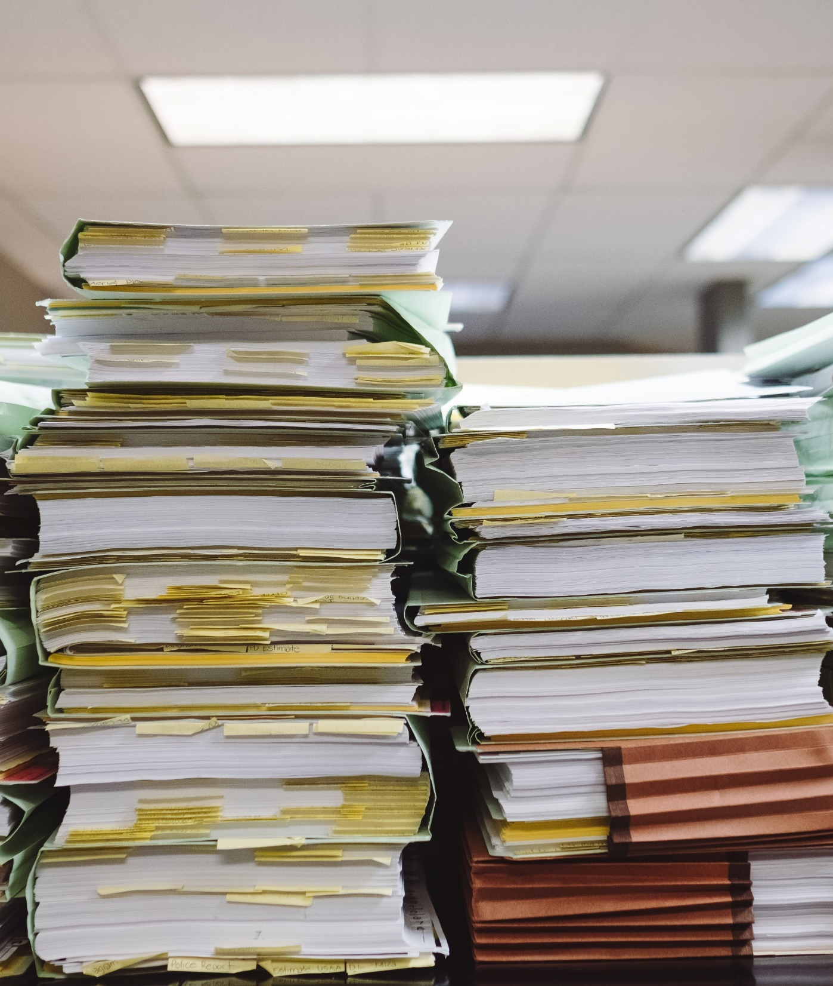
Wrapping Up
Data comes in many formats.
Sometimes it is tabular, semi-structured, or unstructured.
Some formats are nice. Others are not.
Photo by Wesley Tingey on Unsplash

